Slide 1
File Handling in C

Slide 2
What is a File?
A file is a collection of related data that a computers treats as a single unit.
Computers store files to secondary storage so that the contents of files remain intact when a computer shuts down.
When a computer reads a file, it copies the file from the storage device to memory; when it writes to a file, it transfers data from memory to the storage device.
C uses a structure called FILE (defined in stdio.h) to store the attributes of a file.

Slide 3
Steps in Processing a File
Create the stream via a pointer variable using the FILE structure:
FILE *p;
Open the file, associating the stream name with the file name.
Read or write the data.
Close the file.

Slide 4
The basic file operations are
fopen - open a file- specify how its opened (read/write) and type (binary/text)
fclose - close an opened file
fread - read from a file
fwrite - write to a file
fseek/fsetpos - move a file pointer to somewhere in a file.
ftell/fgetpos - tell you where the file pointer is located.

Slide 5
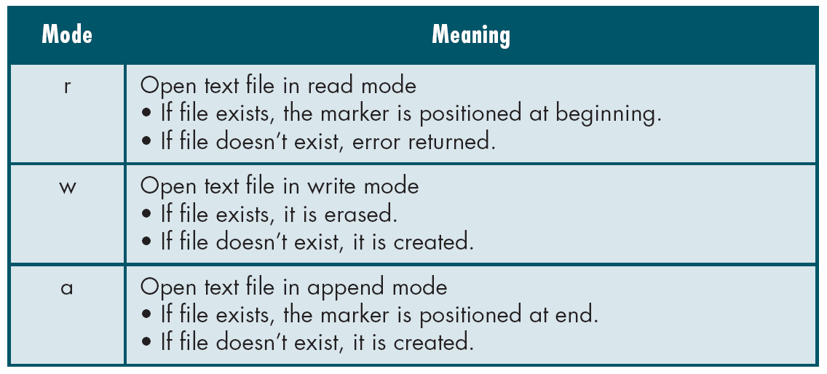
File Open Modes
from Table 7-1 in Forouzan & Gilberg, p. 400

Slide 6
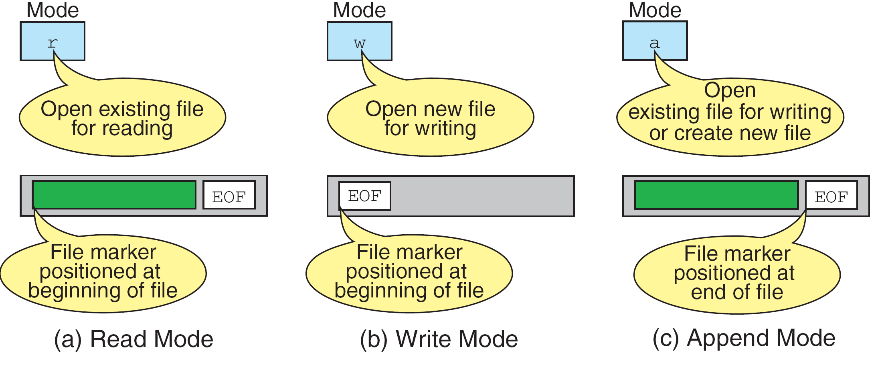
More on File Open Modes
from Figure 7-4 in Forouzan & Gilberg, p. 401

Slide 7
Additionally,
r+ - open for reading and writing, start at beginning
w+ - open for reading and writing (overwrite file)
a+ - open for reading and writing (append if file exists)

Slide 8
File Open
The file open function (fopen) serves two purposes:
  It makes the connection between the physical file and the stream.
  It creates “a program file structure to store the information” C needs to process the file.
Syntax:
filepointer=fopen(“filename”, “mode”);

Slide 9
More On fopen
The file mode tells C how the program will use the file.
The filename indicates the system name and location for the file.
We assign the return value of fopen to our pointer variable:
  spData = fopen(“MYFILE.TXT”, “w”);
  spData = fopen(“A:\\MYFILE.TXT”, “w”);

Slide 10
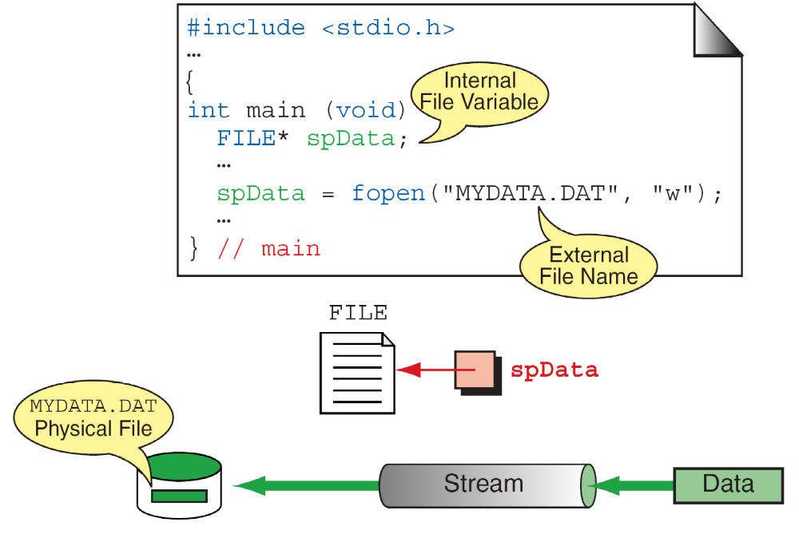
More On fopen
from Figure 7-3 in Forouzan & Gilberg, p. 399

Slide 11
Closing a File
When we finish with a mode, we need to close the file before ending the program or beginning another mode with that same file.
To close a file, we use fclose and the pointer variable:
fclose(spData);

Slide 12
fprintf()
Syntax:
fprintf (fp,"string",variables);
Example:
  int i = 12;
  float x = 2.356;
  char ch = 's';
  FILE *fp;
  fp=fopen(“out.txt”,”w”);
  fprintf (fp, "%d %f %c", i, x, ch);

Slide 13
fscanf()
Syntax:
fscanf (fp,"string",identifiers);
Example:
    FILE *fp;
    Fp=fopen(“input.txt”,”r”);
    int i;
    fscanf (fp,“%d",i);

Slide 14
getc()
Syntax:
identifier = getc (file pointer);
Example:
FILE *fp;
fp=fopen(“input.txt”,”r”);
char ch;
ch = getc (fp);

Slide 15
putc()
write a single character to the output file, pointed to by fp.
Example:
FILE *fp;
char ch;
putc (ch,fp);

Slide 16
End of File
There are a number of ways to test for the end-of-file condition. Another way is to use the value returned by the fscanf function:
FILE *fptr1;
int istatus ;
istatus = fscanf (fptr1, "%d", &var) ;
if ( istatus == feof(fptr1) )
{
printf ("End-of-file encountered.\n”) ;
}

Slide 17
Reading and Writing Files
#include <stdio.h>
int main ( )
{
FILE *outfile, *infile ;
int b = 5, f ;
float a = 13.72, c = 6.68, e, g ;
outfile = fopen ("testdata", "w") ;
fprintf (outfile, “ %f %d %f ", a, b, c) ;
fclose (outfile) ;
infile = fopen ("testdata", "r") ;
fscanf (infile,"%f %d %f", &e, &f, &g) ;
printf (“ %f %d %f \n ", a, b, c) ;
printf (“ %f %d %f \n ", e, f, g) ;
}

Slide 18
Example
#include <stdio.h>
#include<conio.h>
void main()
{
  char ch;
  FILE *fp;
  fp=fopen("out.txt","r");
  while(!feof(fp))
    {
    ch=getc(fp);
    printf("\n%c",ch);
  }
  getch();
}

Slide 19
fread ()
Declaration:
size_t fread(void *ptr, size_t size, size_t n, FILE *stream);
Remarks:
fread reads a specified number of equal-sized
data items from an input stream into a block.
ptr = Points to a block into which data is read
size = Length of each item read, in bytes
n = Number of items read
stream = file pointer

Slide 20
Example
  Example:
  #include <stdio.h>
  int main()
  {
  FILE *f;
  char buffer[11];
  if (f = fopen("fred.txt", “r”))
  {
  fread(buffer, 1, 10, f);
  buffer[10] = 0;
  fclose(f);
  printf("first 10 characters of the file:\n%s\n", buffer);
  }
  return 0;
  }

Slide 21
fwrite()
Declaration:
size_t fwrite(const void *ptr, size_t size, size_t n, FILE*stream);
Remarks:
fwrite appends a specified number of equal-sized data items to an output file.
ptr = Pointer to any object; the data written begins at ptr
size = Length of each item of data
n =Number of data items to be appended
stream = file pointer

Slide 22
Example
Example:
  #include <stdio.h>
  int main()
  {
    char a[10]={'1','2','3','4','5','6','7','8','9','a'};
    FILE *fs;
    fs=fopen("Project.txt","w");
    fwrite(a,1,10,fs);
    fclose(fs);
    return 0;
  }

Slide 23
fseek()
This function sets the file position indicator for the stream pointed to by stream or you can say it seeks a specified place within a file and modify it.
  SEEK_SET Seeks from beginning of file
  SEEK_CUR Seeks from current position
  SEEK_END Seeks from end of file
Example:
#include <stdio.h>
int main()
{
FILE * f;
f = fopen("myfile.txt", "w");
fputs("Hello World", f);
fseek(f, 6, SEEK_SET); SEEK_CUR, SEEK_END
fputs(" India", f);
fclose(f);
return 0;
}

Slide 24
ftell()
offset = ftell( file pointer );
"ftell" returns the current position for input or output on the file
#include <stdio.h>
int main(void)
{
FILE *stream;
stream = fopen("MYFILE.TXT", "w");
fprintf(stream, "This is a test");
printf("The file pointer is at byte %ld\n", ftell(stream));
fclose(stream);
return 0;
}

Slide 25
THANK YOU

